Slide 1
Steam
A case study in the Steam platform’s success
Notes:
Steam is one of the most popular video game digital distribution services currently out there. Steam’s approximate revenue at the time this data was published was close to 30 billion. What makes Steam such a successful business?

Slide 2
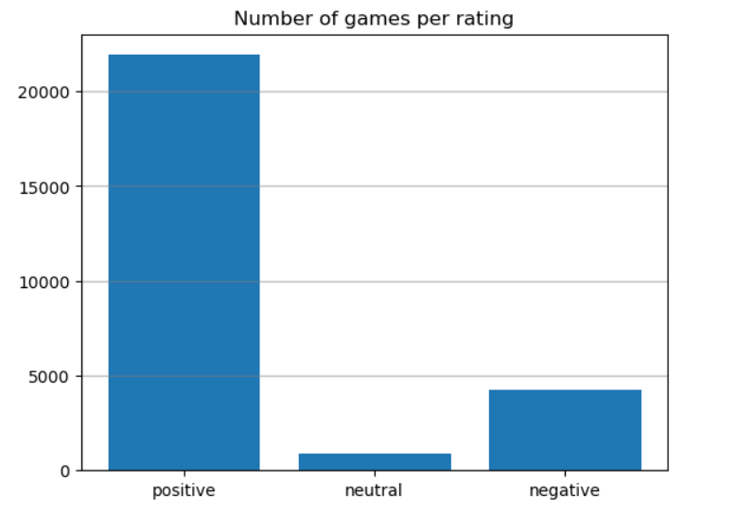
Steam’s success
Notes:
A first look at game ratings within Steam, the vast majority is positive. What is making Steam games so popular? What exactly are they releasing, and how are they promoting their games?

Slide 3
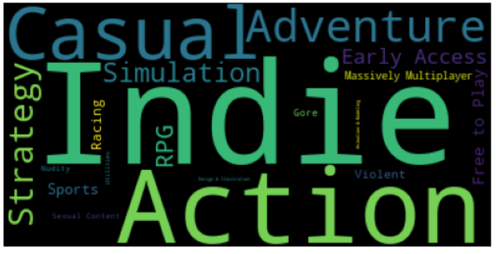
What do they publish?
Notes:
Having a closer look at the types of games they publish, most of them are Indie games and Action games, with casual coming close third.

Slide 4
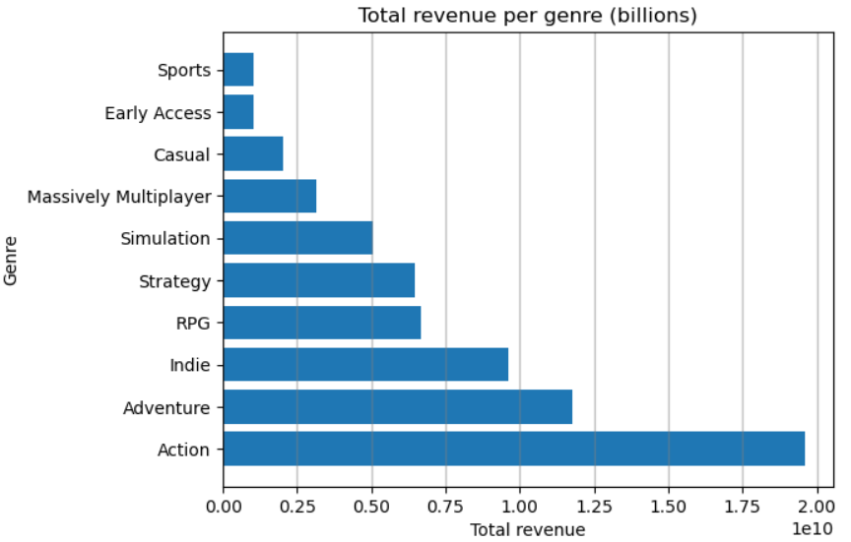
What do they publish?
Notes:
Here we can see Action, Adventure and Indie games are in fact providing a lot of the revenue, being the top three, but casual games aren’t generating that much. Why are they investing in casual games then?

Slide 5
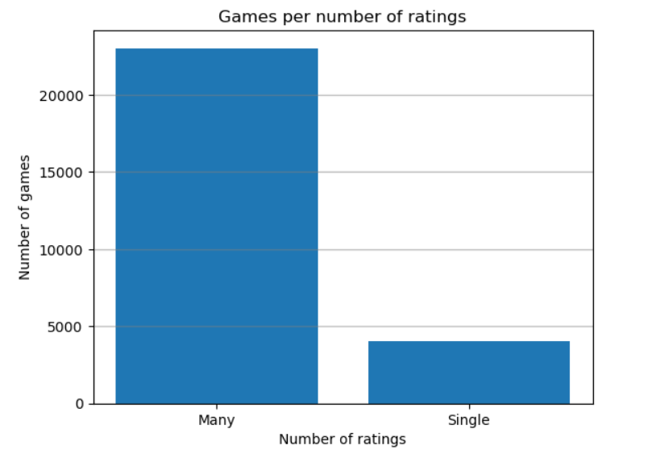
Ratings
Notes:
A closer look at genres published show that most games actually have more than one genre listed. So, what about casual games?

Slide 6
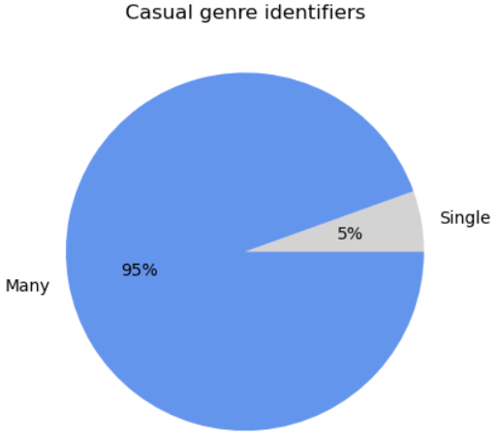
Target audience
Notes:
We can actually see that out of all the casual games published, 95% fit into other genres.
This can be used as a marketing strategy to expose casual gamers to content, making it more likely that casual players will want to buy steam products. This, tied in with the recommendation system (which we are not analysing), could ensure that the right content is being exposed to the correct audience, based on the games being played by casual players.

Slide 7

Casual +
Notes:
In fact, we can see here that amongst all the titles that are classified as casual, the most frequent categories are two others with very high revenue: Indie and adventure games

Slide 8
Conclusion
Which suggests STEAM is using Indie adventure games as a great gateway to access the cohort of casual players into its revenue.
Notes:
Which suggests STEAM is using Indie adventure games as a great gateway to access the cohort of casual players into its revenue.

